Slide 1
… ... Over 4 Decades of Leading the Way with CPD Quality and Innovations ...

Slide 2
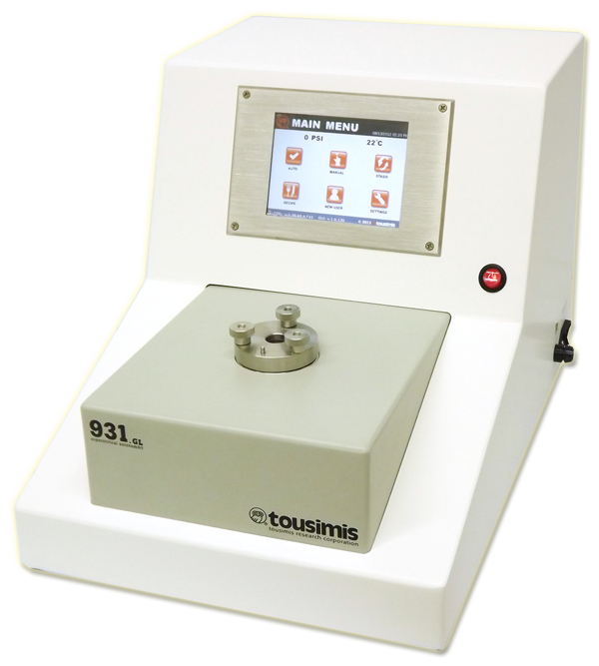
Tousimis is a globally recognized manufacturer of highly reliable Critical Point Dryers.
Autosamdri® 931 with 1.25” Chamber

Slide 3
Company History
1962 tousimis incorporated in Washington, DC by Dr. A.J. Tousimis
1962-1972 tousimis staff works on NASA Apollo Project
1972 tousimis introduces 1st commercial CPD
1978-79 1st US patents for Semi and Auto-CPD processing awarded
1983 Introduces 1st LCO2 filtration supply system for CPD process
1996 Delivers 1st MEMS CPD for 4” wafers
2000 Delivers 1st MEMS CPD for 6” wafers
2002 Receives patents for MEMS Supercritical CO2 Drying Apparatus
2003 Delivers 1st MEMS Series C Stand alone CPD System for 6” wafers
2004 Delivers 1st MEMS Series C Stand alone CPD System for 8” wafers
2007 Develops line of GEL Holders
2011 Develops line of Small Particle Holders
2012 Autosamdri-931 wins Microscopy Today Award for Most Innovative Sample Preparation award
2014 Delivers 1st GEL system with 931 control in an 8” Chamber Configuration

Slide 4
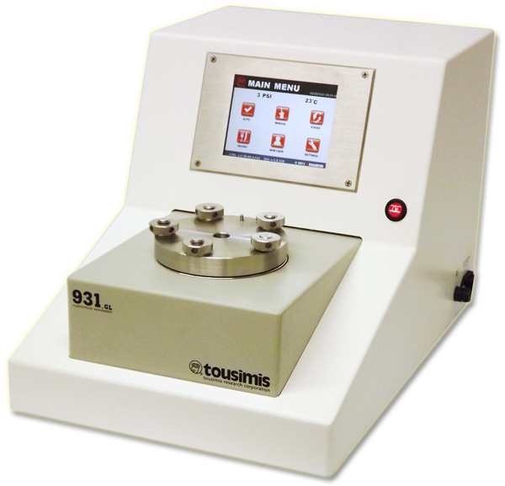
Autosamdri ® -931 History
2011 Introduces next Generation Touch Screen CPD
2012 Awarded Microscopy Today
Innovation Award
Autosamdri® 931 with 3.40” Chamber

Slide 5
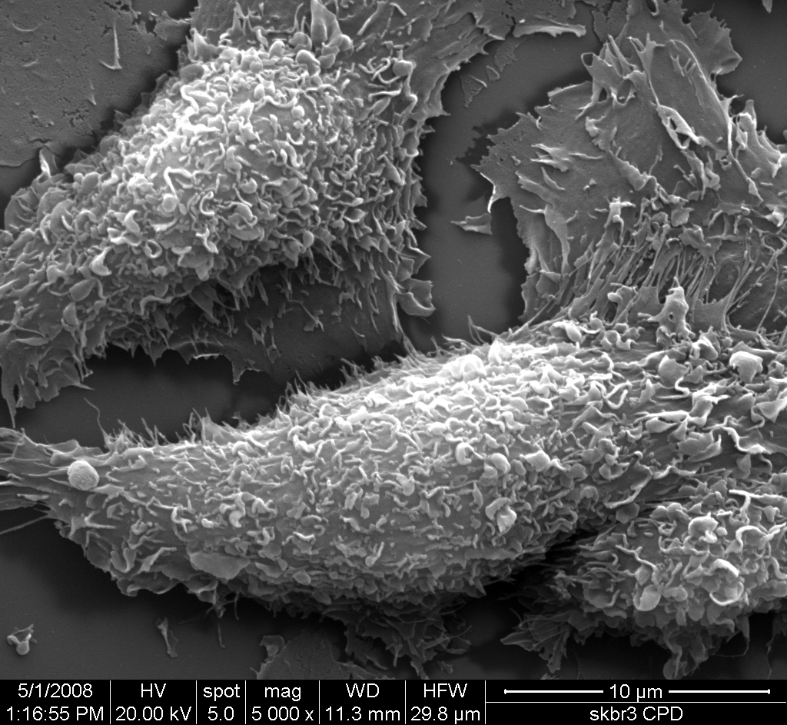
Autosamdri® 931 Processes Delicately Preserves Micro & Nano 3-D Structure with Reproducibility.
Macrophages and Endothelial Cells
The University of Texas Health Science Center at Houston
Dr. Rita Serda / Kathryn Hodges

Slide 6
Autosamdri® 931 Unique Features
New Multi-Application Digital Critical Point Dryer
Patent Pending "Stasis Software" for Challenging Sample Types
Available in 1.25", 2.50" and 3.40" chamber sizes
Winner of 2012 Microscopy Today Innovation Award
Precision process control
Optional "Quick Release" sample holder (down to 2 µm in size)
Program and save custom recipes
Made in U.S.A.

Slide 7
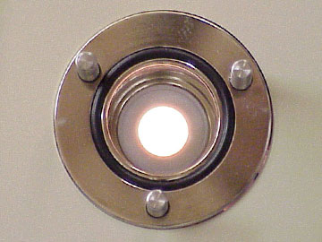
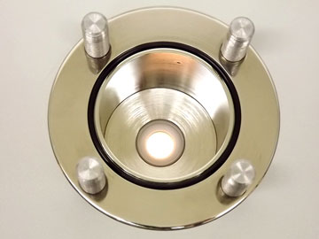
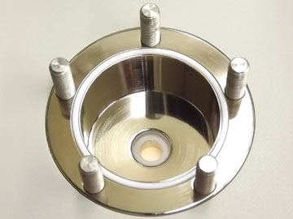
Autosamdri®-931 Chamber Size Options
1.25” ID Chamber
2.50” ID Chamber
3.40” ID Chamber

Slide 8
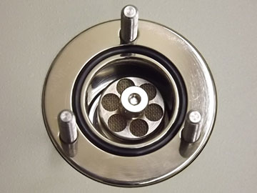
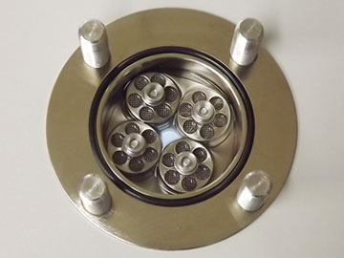
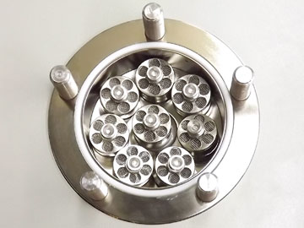
Autosamdri® -931 Chamber Holder Capability
1.25” Chamber
with 1 Sample Holder
2.50” Chamber
with 4 Sample Holders
3.40” Chamber
with 8 Sample Holders

Slide 9
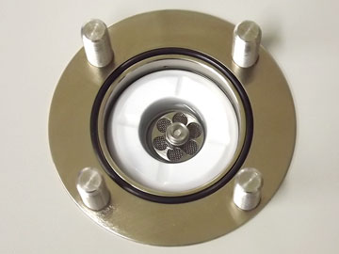
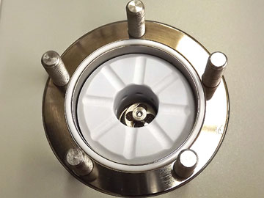
Autosamdri® -931 Chamber Insert Views
1.25” I.D.
2.50” Chamber
with Chamber Insert
3.40” Chamber
with Chamber Insert

Slide 10
Patent Pending Stasis Software

Slide 11
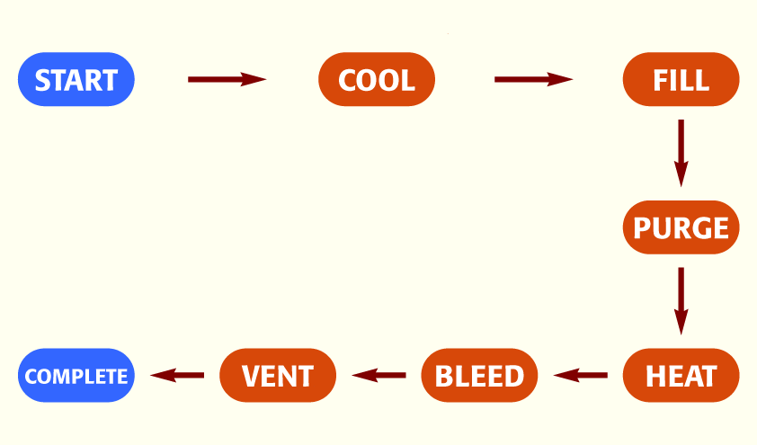
Traditional tousimis® CPD Auto-Process Overview

Slide 12
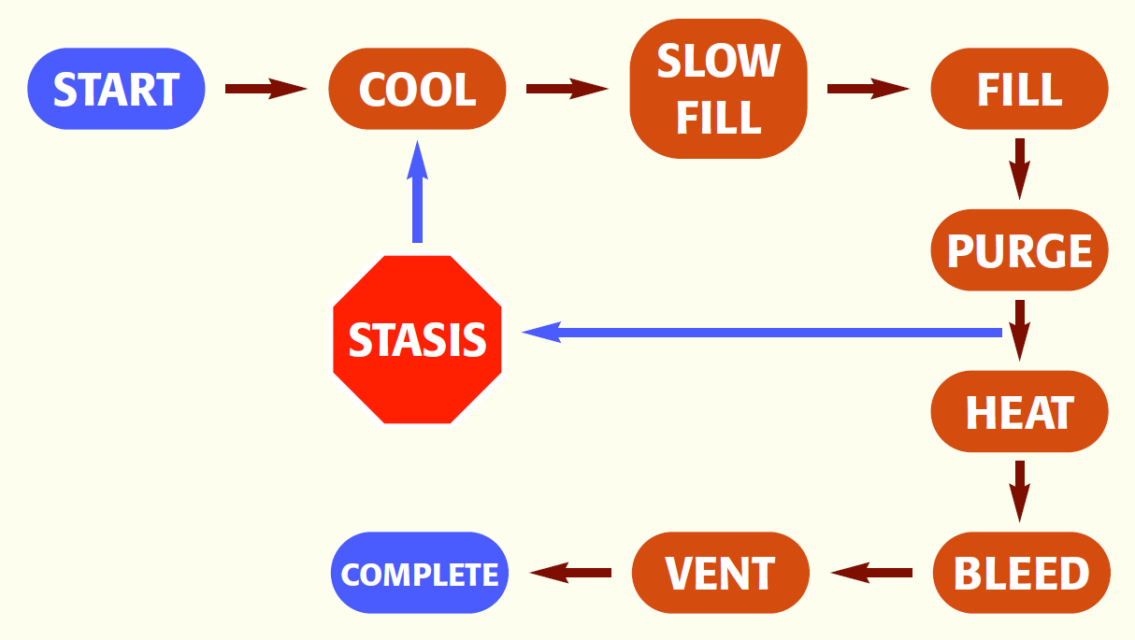
“Stasis” Process Overview

Slide 13
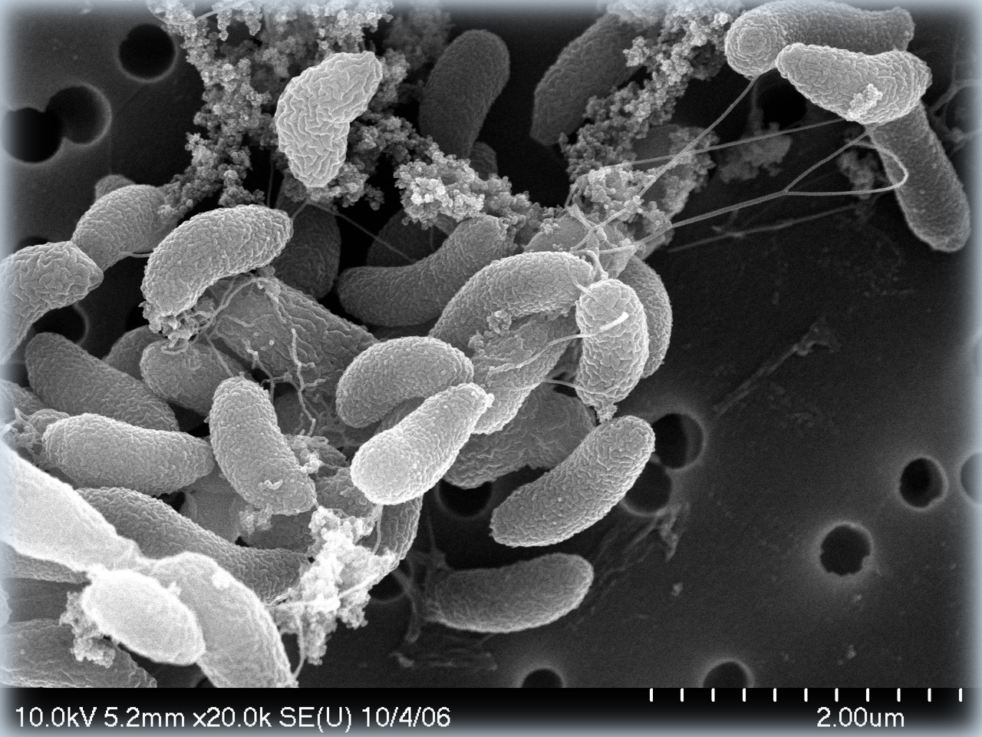
Over four decades of experience perfecting our technique with ground breaking design and patented firsts have created our present day technological edge.
Bacteria with Nanowires
University of Missouri - EM Core Facility
Dwayne Elias

Slide 14
Autosamdri® 931 Additional Features
Characteristic | tousmis® Autosamdri® 931
Fully Automatic Operation | Yes
Factory Preset Automatic Protocol | One touch Automatic Operation Works for Many Sample Types
Chamber Inserts | Yes. Saves LCO2 Consumption and Process Time
External Supply LOC2 Filtration | Yes. Removes Oil / Water / Particle
Internal Inlet LCO2 Filtration | 2 x 0.5μm Pre-Chamber, 1 x 0.5μm Post-Chamber
Cooling Method | Adiabatic (No Maintenance Required)
Chamber Stir Method | Patent Pending Chamber Design creates natural stirring vortex
Chamber Decompression Technique | 2 Step Method: Initial gentle and then more rapid vent controls
Internal SOTER™ Condenser | Yes (Thermostatically controlled - S.S. Reservoir)
2 Year Warranty on all parts & Labor | Yes

Slide 15
Autosamdri® 931 Applications:
Biological Samples
MEMS
Bio-MEMS
AeroGEL
Nano Particle
Carbon Nanotubes
Graphene
MOF
Others

Slide 16
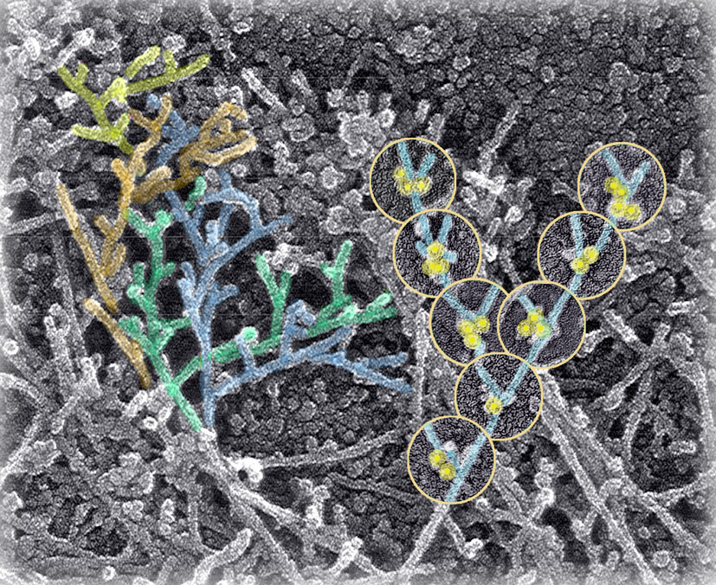
Structure of the cytoskeleton near a fibroblast
University of Pennsylvania, Philadelphia, PA
Prof. Tatyana Svitkina

Slide 17
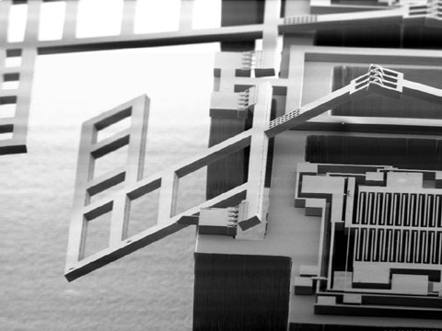
Silicon Microrobots - Leg of robot
University of California at Berkeley and Micropropulsion Corp. USA
Seth Hollar and Anita Flynn

Slide 18
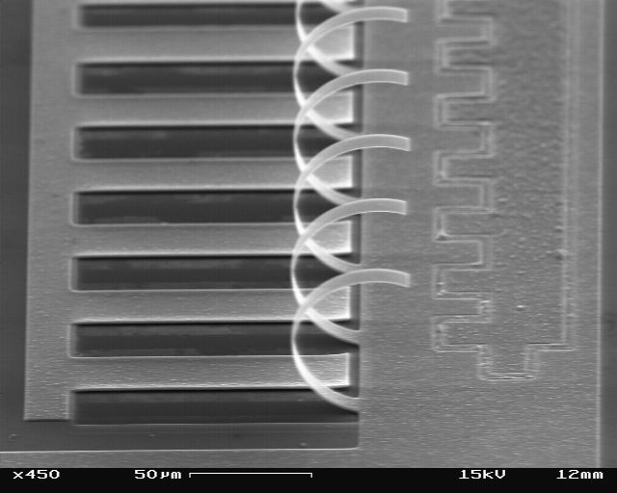
Thermal Actuated Actuators
Université Catholique de Louvain
Nicolas André

Slide 19
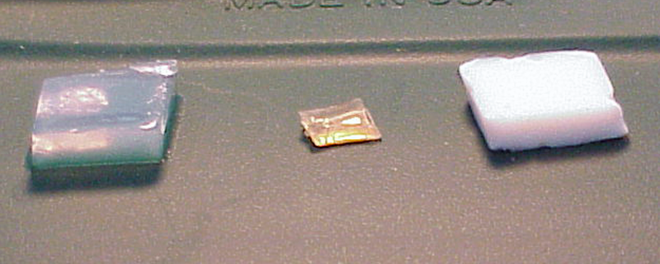
SAMDRIED™ vs. AIRDRIED Sol-Gel
SOL-GEL
0.1% solids in H2O Alcohol Dehydration
SAMDRIED™
SOL-GEL
1.0% solids in H2O Alcohol Dehydration
AIRDRIED
SOL-GEL
1.0% solids in H2O Alcohol Dehydration
SAMDRIED™
Tousimis Research Corporation
Rockville, MD

Slide 20
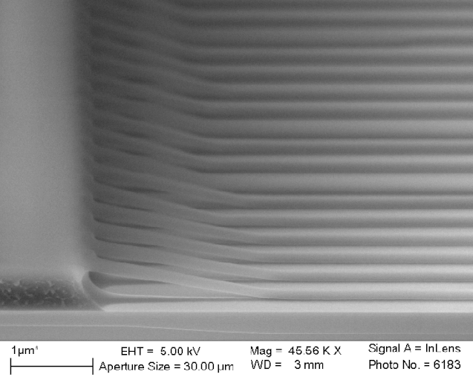
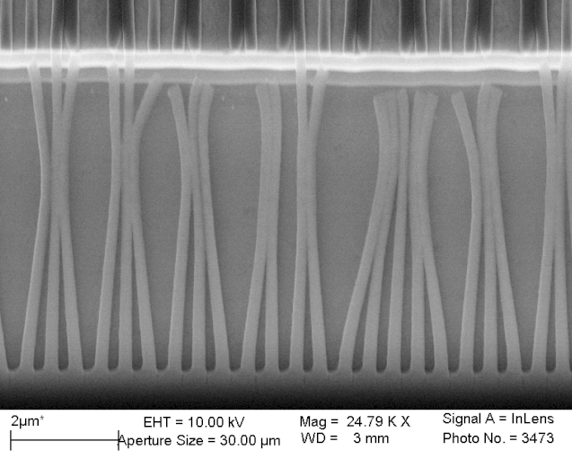
Failed attempts to get thick (~200 nm) and high repetitive(~ 500 nm) film
❖ Single thick e-beam resist
- Resist pattern collapsed each
other during drying process.
◆ Bi-layer e-beam resist
- top resist pattern couldn't sustain
and collapsed down.
NRL NanoFab - Washingtopn, DC
Chul-Soo Kim

Slide 21
Thank You!
… ... Over 4 Decades of Leading the Way with CPD Quality and Innovations ...

